Slide 1
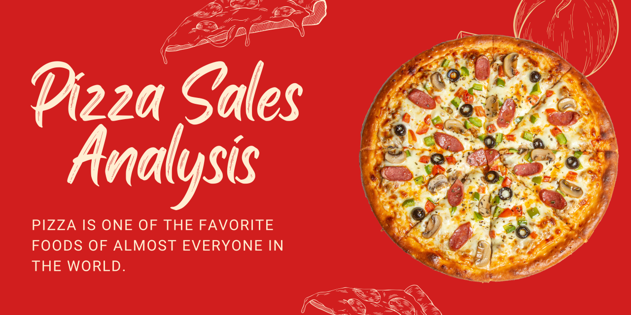
Presented By:
Tanwita Kar
Ivy Professional School

Slide 2
Overview of the Project
In this competitive era, pizza industry can be recognized as the most profitable business all over the world
At this moment the global pizza industry has $160 Billion market
With extensive amount of increase in pizza sales all over the world the Global Pizza market has anticipated to rise in a significant rate within 2023-2030
The following project consists of a dataset based upon detailed results regarding annual pizza sales in the country
Based upon the given data, relevant business analysis will be conducted and crucial data will be showcased using relevant dashboards using Advanced Excel

Slide 3
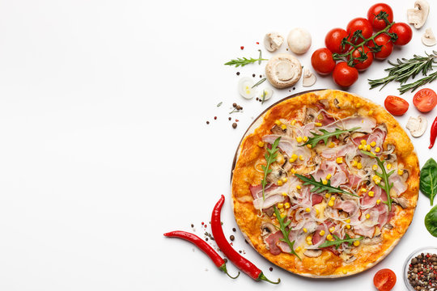
Contents
To analyse the top most favourite pizzas sold by the company throughout the year
To recognise the least favourite pizzas among the customers
To analyse pizza sales based upon size of pizza and categories
To understand the most favourite category of pizza among the customers
To evaluate total sales on a monthly basis through pizza business
To recognise top 5 customers purchasing highest number of pizzas throughout the year
To get an idea regarding how many pizzas are generally in order? Is there any bestsellers ?
To recognise the peak hours in pizza outlets
To evaluate the number of customers visit the outlets each day

Slide 4
Business Insights I
From the bar chart it is evident that the Classic Deluxe Pizza is the highest bestselling product in the company
It showcases that 2453 numbers of Classic Deluxe pizzas have been sold throughout the year
At the same time Barbeque Chicken pizza, Hawaiian Pizza, Pepperoni Pizza and The Thai Chicken pizza are consecutively top 4 most sold pizzas among the customers
As most of these pizzas belong to the Classic category the company needs to concentrate upon developing the Classic style pizzas with more effort

Slide 5
Business Insights II
It is evident that “Classic” and “Supreme” pizza slices are most favourite based upon the quantity of pizzas sold over the year
This second bar chart represents total amount of sales achieved through different category pizzas
It has been analysed that “Classic” pizzas have 24% and 27% more sales than “Supreme” and “Veggie” pizzas in the market
So, manufacturing more “Classic” and “Supreme” pizzas will help in increasing the brand name among the potential customers and sustaining significant amount of revenue in business

Slide 6
Business Insights III
In order to do sales trend data analysis, line graph has been obtained
The result displays total sales achieved by the company by selling pizzas among the customers from January to December in that particular year
The peaks and troughs of trend analysis represents tumutuous journey of the company
However in July, May and March months company has gained highest amount of sales
It needs to take under consideration that sales dropped significantly during the festive season after November

Slide 7
Business Insights IV
The following Bar chart has been designed using hourly sales dataset in different date
Chart shows most of the customers visit the pizza outlets between 12PM to 1PM. Again during 5 to 7 PM those outlets recieve significant amount of customers
It can be suggested that mostly office going people, young college kids try to taste the pizzas in their breakfast and evening meal

Slide 8
Business Insights V
It has been evaluated that the Brie Carre pizzas make only 1 percent of total pizza sales for the organisation
From this horizontal bar chart it can be visualised that “S” size “Brie Carre Pizza” has very low sales
Only 11588 Brie Carre pizzas have been sold
Hence proper action need to be taken

Slide 9
Business Insights
It has been detected that there is only one pizza variant in “XXL” size.
The Greek Pizza being the only one name in this
Although it is a Classic pizza, this pizza has almost no contribution in total sales of the company
Hence such incomprehensive ideas must be taken under consideration

Slide 10
Business Insights
During the peak hours on an average almost 5645 pizzas are sold
The “Barbecue Chicken Pizza”, “California Chicken Pizza”, “Classic Deluxe”, “Spicy Italian Pizza” and “The Thai Chicken Pizza” are the top 5 products contributing highest sales in the business throughout the year

Slide 11
Conclusion
Throughout the analysis it is evident that the company has achieved $817.86K from pizza business in the market
As Global pizza industry is ever booming the company need to strategise the business based upon the past history
To enhance business during festive season company can provide great deals and offers in every purchase of pizzas, modifying menus with special ingredients to attract potential customers
As “Brie Carre Pizzas” and “XXL” size “The Greek Pizzas” have minimal contribution in developing the business, these two categories need to be removed from the menu
On an average 5645 pizzas are sold during peak hours. Hence company must take action regarding maintaining the workforce in pizza outlets to serve the valuable customers

